Slide 1
Grid Modernization at Unitil Grid-Facing and Customer-Facing Activities and Plans
Electric Grid Modernization Working Group Kick-Off Workshop
November 14, 2012

Slide 2
Smart Grid Framework

Slide 3
NETL Smart Grid Implementation Strategy
Until Follows the NETL Smart Grid Implementation Strategy (previously NETL’s Modern Grid Initiative).
NETL defines Smart Grid objectives in six value areas.
It must be more reliable
It must be more secure
It must be more economic
It must be more efficient
It must be more environmentally friendly
It must be safer
SG functionality is defined around seven principal characteristics.
Smart Grid Characteristics*
Self-healing.
Incorporates and motivates the consumer.
Resists attack.
Provides power quality for 21st century needs.
Accommodates a wide variety of generation options.
Enables markets.
Optimizes assets and operates efficiently.
* U.S. National Energy Technology Laboratory

Slide 4
Key Driver (Unitil)
Declining load factor caused by increased penetration of A/C; lower system utilization.
System becoming increasingly “peaky”.
Capital investment increasingly driven by extreme peaks.
Demand Resources offer opportunity to eliminate, shift or better manage peak demand.
Extreme peaks drive capital investment
20% of peak demand is experienced during just 1% of annual hours.

Slide 5
Challenges
20th Century Grid
Does not easily accommodate distributed generation or other distributed resources.
21st Century Grid
Must integrate a wide array of distributed load, storage and generation resources.
Planned and designed exclusively around centralized generation.
Radial topology; “one way” power flow.
Network topology with sophisticated protection, communication, metering, and intelligence.
Hybrid system, “two way” power flow.
Limited communication infrastructure; limited control and monitoring.
Limited metering and pricing information; consumer behavior not incorporated.
Must incorporate consumer behavior to enhance efficient utilization and consumption of electricity, while delivering improved reliability and power quality.

Slide 6
Customer Facing Initiatives

Slide 7
Advanced Metering (AMI)
Full system deployment completed in 2007 (100% of customers).
Multi-utility endpoints – gas and electric.
Fixed network transmitting over power lines. Power Line Carrier (PLC) communication using Ultra-narrow-bandwidth (UNB) technology.
Daily reporting of consumption data.
Bi-directional communication.
“Always On” connectivity model.
Remote configuration of demand meters and TOU meters.

Slide 8
Smart Grid Pilot Program
Time-differentiated rate structure featured on-peak, off peak and critical peak periods.
Three technology groups were evaluated: Simple TOU, Enhanced Technology, Smart Thermostat.
All participants were provided with access to a web portal that provided information on daily energy consumption and estimated costs, as well as notifications on CPP days.
Promising results in terms of consumer behavior and demand reduction during peak periods.

Slide 9
Technologies Explored
Energy Storage/Permanent Load Shifting
Thermal Energy Storage (e.g., ice storage)
Battery storage
Distributed generation
Small Wind
PV Systems
Landfill Generation
Conservation Voltage Optimization
Direct Load Control
Gas Cooling
And many others….

Slide 10
Grid Facing Initiatives

Slide 11
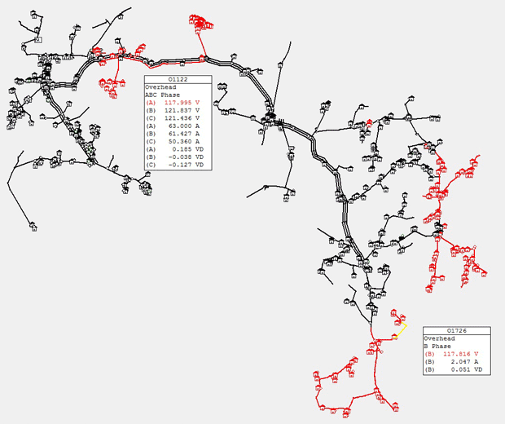
AMI Grid Facing Features
AMI integration with GIS provides meter communications diagnostics and the ability to find loose power connections.
Electric system monitoring, including end of line voltage monitoring.
Better estimates of load shapes and peak load conditions of specific circuits.
Improved system modeling data, using per phase and per customer load data from AMI.
Improved service transformer sizing, using AMI capture of every customers’ daily peak demand.
Daily Watt/Var data at step transformers utilizing standard AMI meters.

Slide 12
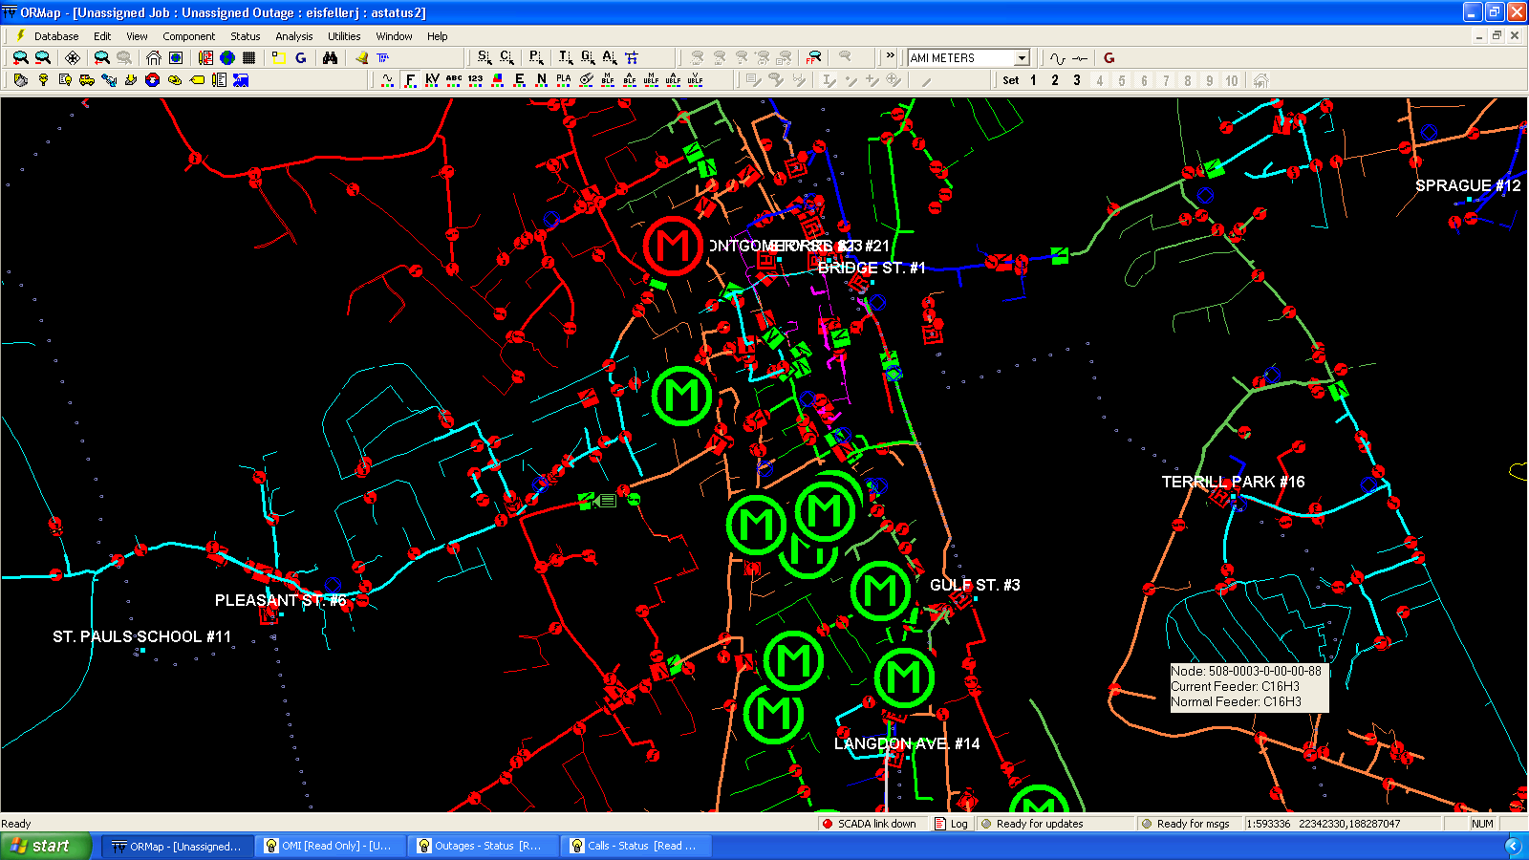
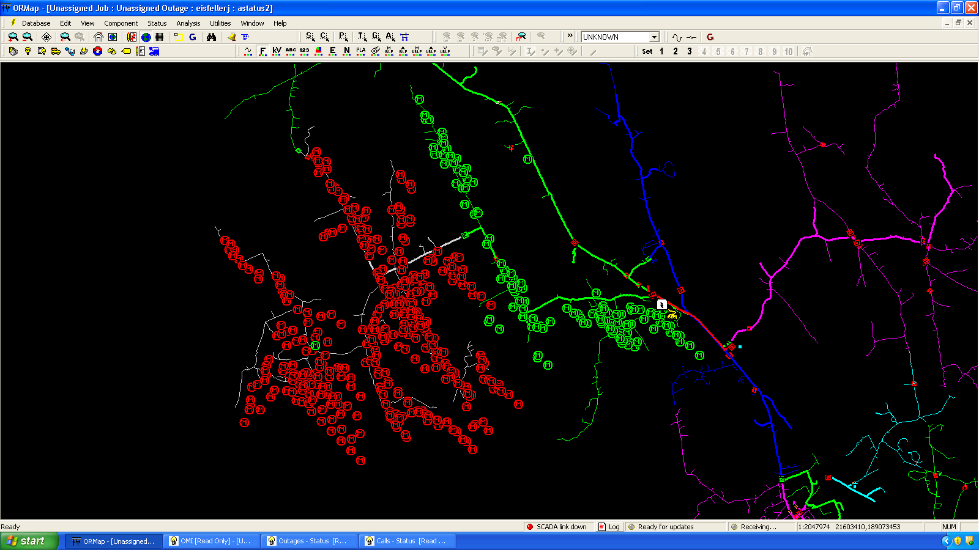
AMI / OMS Integration
Integration of AMI data (“Always On” connectivity) provides near real time outage information.
Determine extent of outage.
Locate outages w/ no customer calls.
Confirm outage restoration.
Find unrestored sections of circuit (nested outages or pockets).
Provides valuable information to operators to validate OMS outage predictions.
Provides operators with a tool to improve accuracy of OMS data.

Slide 13
Longer Term Plans
Continued enhancement of AMI including data streaming capable of providing hourly load and/or voltage data. Future upgrades to include 15 minute data intervals at every endpoint
Increased penetration of SCADA further downstream on the distribution system.
Enhanced and expanded communication infrastructure.
Increased use of mobile data systems, field data collection.
Distribution automation – automated switching, fault sectionalizing and restoration.
Storm resiliency – evaluate, design and implement facilities and equipment that are more resilient (or reliable) for storm events.

Slide 14
Organization
Realigned functions related to metering, substations, and system operations. Strategic emphasis on emerging smart grid technologies. Areas considered:
New requirements for time-based pricing; including possible emergence of real time pricing programs.
Potential for increased penetration of distributed energy resources including demand response and distributed generation.
Outage management systems and advanced control of grid operations.
Emerging smart grid technologies including communication and protection systems.
Revisiting organizational design and job design concurrent with the ongoing wave of retirements to ensure skills are aligned with the Company’s strategic vision for smart grid advancement.
Strong management and technical leadership with direct operational responsibility for smart grid functions.
Reevaluate educational requirements and training for new workers in areas of protection, metering, substations, linework, etc.

Slide 15
Questions?

